Slide 1
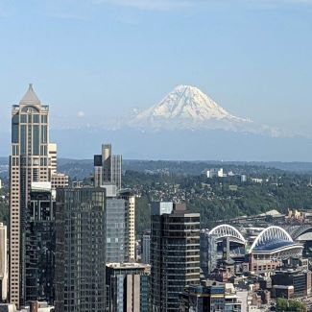
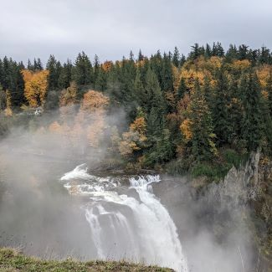
AWRA 2022
Annual Water
Resources Conference
November 7-9
Seattle, WA
USA
#AWRA2022
awra.org

Slide 2
2022 Annual Water Resources Conference
[INSERT SESSION TITLE]
[INSERT SESSION NUMBER]
PRESENTERS: [Insert presenter information]
All rights reserved. No part of this presentation, publication, research or materials may be reproduced, distributed, or transmitted in any form or by any means, including photocopying, recording, or other electronic or mechanical methods, without the prior written permission of the author(s).

Slide 3
Thank you for participating!
Contact us with questions:
Presenters: [Insert presenter names and contact information]
All rights reserved. No part of this presentation, publication, research or materials may be reproduced, distributed, or transmitted in any form or by any means, including photocopying, recording, or other electronic or mechanical methods, without the prior written permission of the author(s).

